Slide 1




Measuring Fairness in Ranked Results: An Analytical and Empirical Comparison
Amifa Raj
‹#›
Grant No. IIS 17-51278

Slide 2


2022
Raj, A., & Ekstrand, M. D. (2022, July). Measuring Fairness in Ranked Results: An Analytical and Empirical Comparison. In Proceedings of the 45th International ACM SIGIR Conference on
DOI 10.1145/3477495.3532018

Slide 3
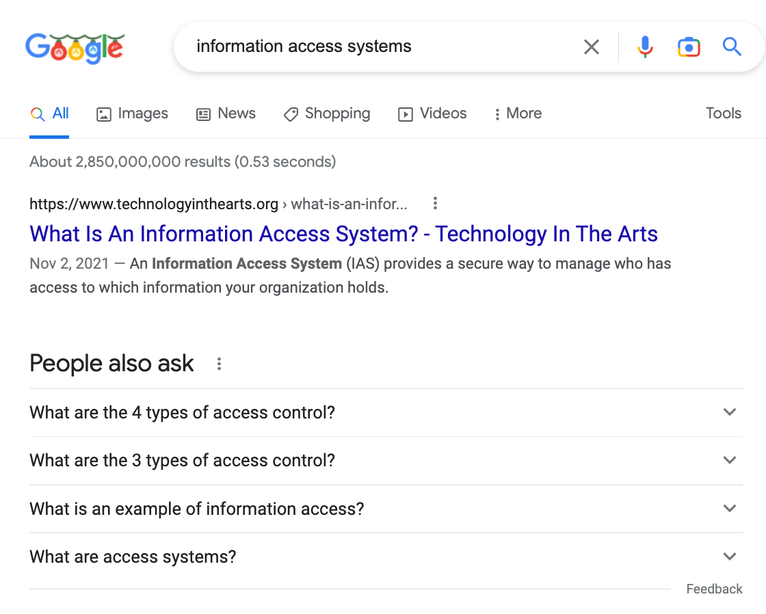



query

Slide 4










Provider
Consumer

Slide 5




Slide 6
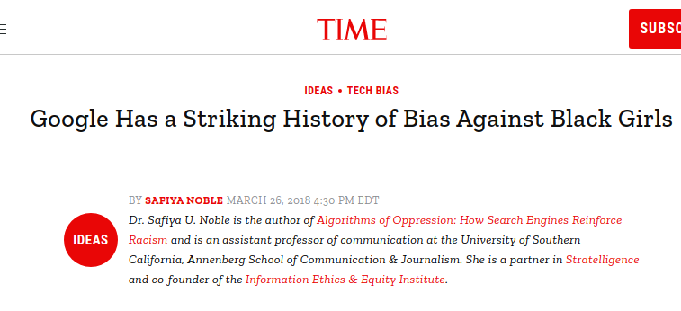



Slide 7
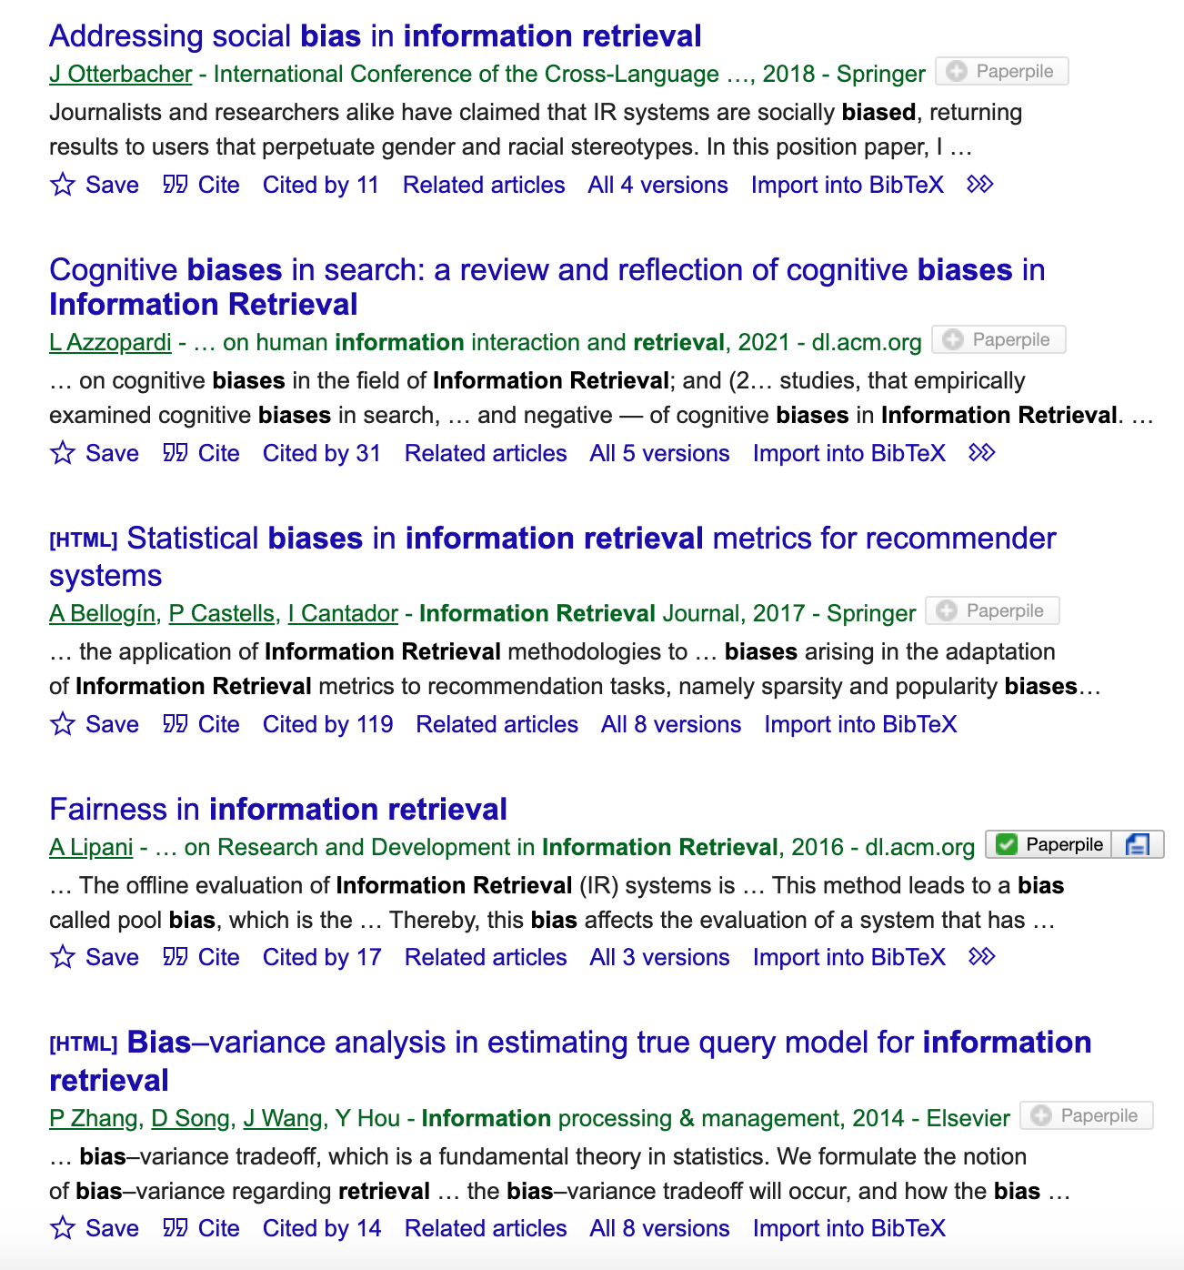
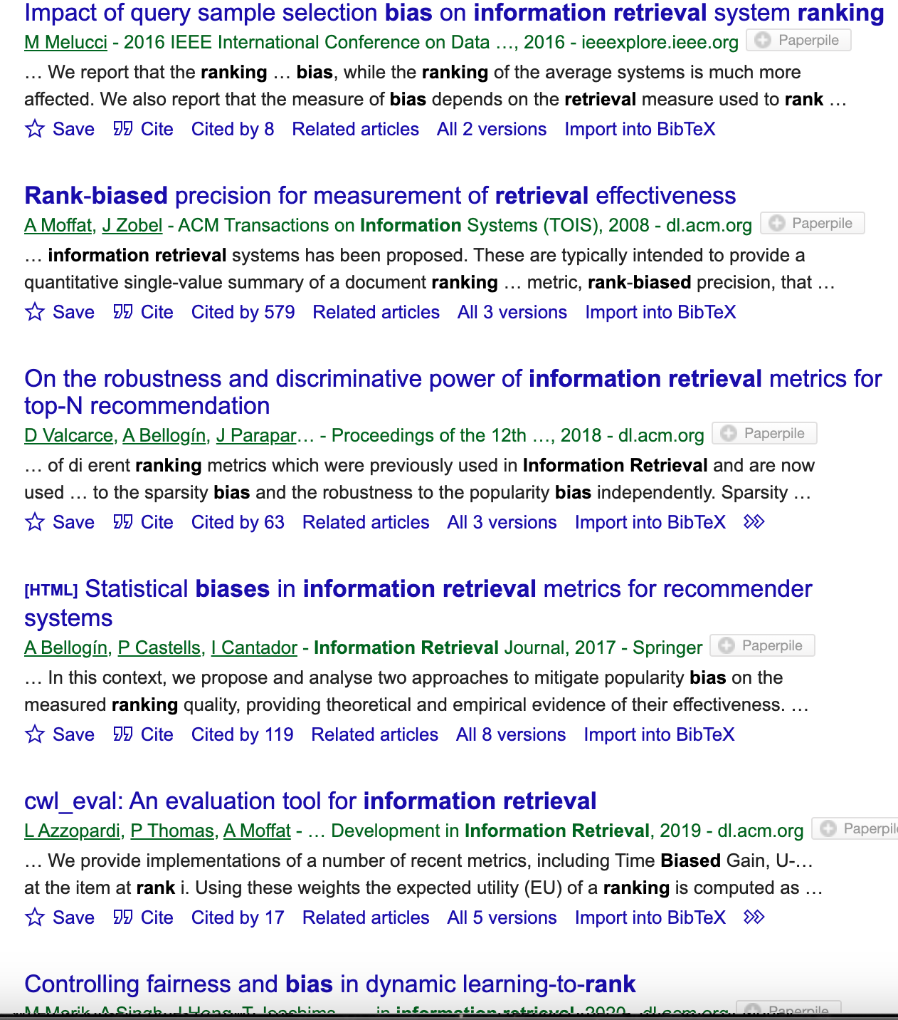
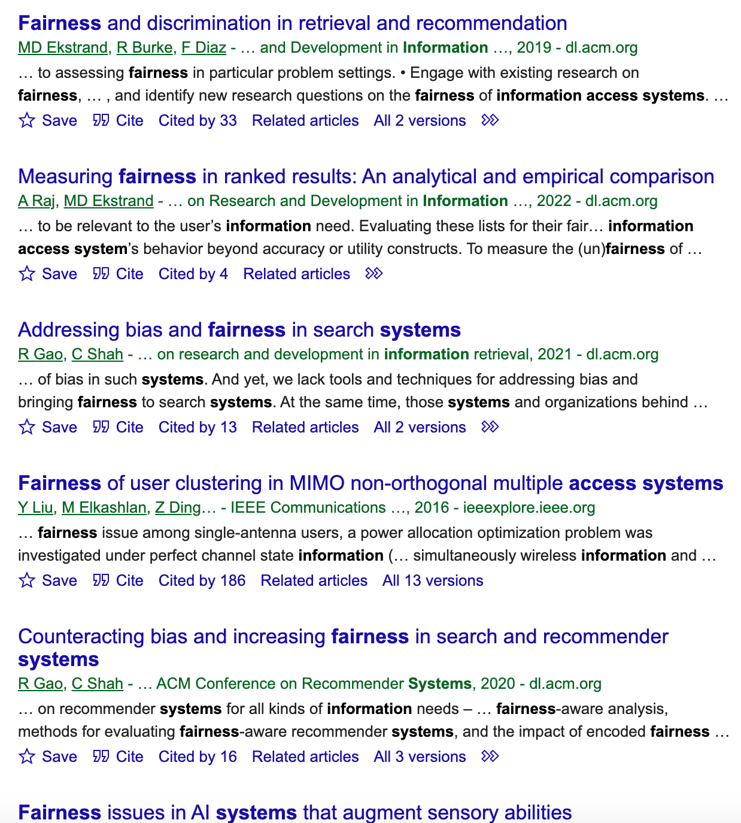

Slide 8
Bias
Difficult to define
Domain dependent
Systematic and unfair discrimination against certain individual or group entities by denying opportunity and assigning unfair outcomes
Group (Sensitive Attributes) and Individual Fairness

Slide 9




1
User Request
2
3
4
Exposure
5
6
Attention
Ranked Items
Providers
Consumer

Slide 10


Disparate Exposure
1
2
3
Attention
4
5
6
Ranked List

Slide 11
Fairness Positioning
Geography
Age
Race
Gender
Economic status
Sensitive Attributes
Provider Fairness
Group Fairness

Slide 12
Fair Ranking Metrics
PreF𝚫 (Yang et. al.; SSDBM ‘17):
AWRF (Sapienzynski et. al.; WWW’19)
EEL, EED, EER Diaz et.al.; CIKM’20)
FAIR (Zehlike et.al.; CIKM’17)
IAA (Biega et. al.; SIGIR’18)
DP, EUR, RUR (Singh et.al.; KDD’18)

Slide 13


No Comparative and Comprehensive Analysis
Several Fair Ranking Metrics

Slide 14



Why is the Problem a Problem?
Finding suitable Metrics
Differences among the Metrics
Implementation in Real-world IAS dataset

Slide 15
Research Questions
RQ1. What are the conceptual differences among the fair ranking metrics?
RQ2. What is needed to apply these metrics to real IAS?
RQ3. What are the design decisions and parameters involved, and how sensitive are the resulting metrics to those decisions?
RQ4. What are the empirical differences in how these metrics assess the relative fairness of different recommendation algorithms or retrieval runs?

Slide 16
Research Tasks
Implementing Fair Ranking Metrics in Real-World IAS Datasets
Conceptual Analysis of Fair Ranking Metrics
Sensitivity Analysis

Slide 17
Metrics Design Decomposition
Fairness Goal
What does it mean to be fair?
attention

Slide 18
Fairness Goal
Relevance
Exposure/Attention
Group A
PreF𝚫, FAIR, AWRF, DP, EED
IAA, EUR, RUR, EEL, EER
Item position should not be affected by membership
Exposure/attention should be proportional to relevance
Statistical Parity
Equal Opportunity
Group B

Slide 19
Metrics Design Decomposition
Fairness Goal
Browsing Model
What does it mean to be fair?
How to measure position weight?
attention

Slide 20
Browsing Models
Parameters
Cascade
visiting probability exponentially decreases with position
Patience Parameter
visiting probability depends on relevance of visited items
RBP
Logarithmic
Stopping Probability
visiting probability exponentially decreases with position
visiting probability logarithmically decreases with position
Geometric

Slide 21
Metrics Design Decomposition
Fairness Goal
Browsing Model
What does it mean to be fair?
How to measure position weight?
Target Exposure
attention
Compare system exposure with what?

Slide 22
Target Exposure
Population estimator
From full ranking
Configured
Ideal exposure based on relevance
Estimated utility (Predicted relevance)

Slide 23
Metrics Design Decomposition
Fairness Goal
Browsing Model
What does it mean to be fair?
How to measure position weight?
Target Exposure
Relevance
attention
Compare system exposure with what?
How to incorporate relevance?
Group Membership
Does it allow multinomial and soft group association?

Slide 24


Group Membership
Multinomial Protected Attributes
Non-Binary Groups, such as gender
Soft Group Association
Partial or mixed group membership such as race
Pinney, C., Raj, A., Hanna, A., & Ekstrand, M. D. (2023)
Much Ado About Gender: Current Practices and Future Recommendations for Appropriate Gender-Aware Information Access.
To appear in CHIIR 2023 proceedings.
https://arxiv.org/abs/2301.04780

Slide 25
Summary of Fair Ranking Metrics
Metric(s) | Goal | Weighting | Relevance | Binomial?
PreFd | Each prefix representative of whole ranking | ❌ | ❌ | Dep on d
FAIR | Each prefix matches target distribution | ❌ | ❌ | ✓
AWRF | Weighted representation matches population | Geometric | ❌ | ❌
DP | Exposure equal across groups | Logarithmic | ❌ | ✓
EUR | Exposure proportional to relevance | Logarithmic | ✓ | ✓
RUR | Discounted gain proportional to relevance | Logarithmic | ✓ | ✓
IAA | Exposure proportional to predicted relevance | Geometric | Predicted | ❌
EEL, EER | Exposure matches ideal (from relevance) | Cascade, Geom | ✓ | ❌
EED | Exposure well-distributed | Cascade, Geom | ❌ | ❌

Slide 26
Statistical Parity
Exposure/Attention
AWRF
(Sapienzynski et. al, WWW’19)
Expected cumulative exposure(Group B x position weight) >=p
Target distribution is the group distribution in entire ranked list (true demographics)
Group A
no relevance information
geometric attention decay
non-binary group membership
uses a target distribution to compare
PreF𝚫 (Yang et. al, SSDBM’17) and FAIR (Zehlike et. al, CIKM’17) differ in measuring position weight and allowing multinomial groups.
Group B

Slide 27
Sequences of Ranking
Statistical Priority
DP, EED
…
Equal Opportunity
IAA, EUR, RUR, EER, EEL

Slide 28
Equal Opportunity
EE*
(Diaz et. al, CIKM’20)
Relevance
Exposure/Attention
EEL(Expected Exposure Loss): ||target-system||2
EER (Expected Exposure Relevance): Exposure-relevance distribution
stochastic ranking
rbp & cascade attention decay
non-binary group membership
IAA (Biega et. al, SIGIR’18) differs in weighting strategy, group membership, and relevance
EUR, RUR (Singh et. al, SIGKDD’18) differs in weighting strategy and group membership

Slide 29
Task 1 Findings
Task 1: Conceptual Analysis Fair Ranking Metrics
Metrics are conceptually similar with common components like relevance, browsing model, aggregation, target exposure
Metrics differs in their design choices and fairness assumption
Metrics with same goal can have different design choices

Slide 30
Implementing the Metrics
Search
(retrieval and re-reranking
Recommendations
GoodReads Bookdata
FairTREC 2020
Dataset
Sensitive Attributes
Socio-economic status of author country
Author Gender
Participants provided
Algorithms
CF (implicit feedback)
https://fair-trec.github.io/

Slide 31





Challenges in Implementation
IAA, EE*, DP, EUR, RUR
AWRF, IAA, DP, EUR, RUR, EE*
Missing Relevance Information
All the metrics
Parameter Setting
Missing Group Label
PreF𝚫, FAIR, IAA, DP, EUR, RUR
PreF𝚫 and RUR: suffer from missing data (sparsity) problem
Reformulated ratio-based metric to smoothed log ratio
Soft Group Association
Non-binary groups
Extreme Imbalance

Slide 32
Task 2 Findings
Task 2: Implementing Fair Ranking Metrics in Real-World Datasets
Missing data, missing relevance information, ranked list size are crucial/delicate factors in implementing metrics.
Metrics with similar fairness goals differ in their ease of implementations

Slide 33
Sensitivity Analysis
Ranked-list size
Weighting Strategy
Parameter Settings
No effect on metrics for FairTREC
Ratio-based metrics and FAIR showed sensitivity
Default parameters
EEL and logRUR showed high sensitivity
Almost all metrics showed sensitivity
logRUR is extremely sensitive

Slide 34
Task 3 Findings
Task 3: Sensitivity Analysis
Metrics differ in their sensitivity towards external factors.
High sensitivity towards design choices add complexity in the usability of metrics

Slide 35
Key Findings
Defining metrics in unified framework
Metrics are surprisingly similar
Missing data, missing relevance information, ranked list size are crucial/delicate factors in implementing metrics.
Implement the metrics in same experimental setup
Sensitivity Analysis
Metrics differ in their sensitivity towards external factors.

Slide 36
Recommendations
Allow multinomial protected attributes | Allow soft group association | Sensitivity towards design choices
AWRF | AWRF | AWRF
EED | EED | EED
EER, EEL | EER, EEL | EER, EEL, IAA
Single-list metrics
FAIR, AWRF
Demographic Parity in Sequence
DP, EED
Equal Opportunity in Sequence
EUR, RUR, IAA, EER, EEL

Slide 37
Research Directions
Simulation study to understand the impact of crucial factors in metric implementation.
Incorporating various browsing models
Missing label
Missing or sparse relevance
Ambiguous or multiple group association
Robust, explainable, and efficient metric design

Slide 38
THANK You!

